Slide 1









Al-Powered IT Procurement &
Competitive Product Intelligence
Mentor : Hundare Saurabh
Team S
Team Members
Santhosh kanna T | Shogith G K | Sanjay Kumar U
Revanth K S | Kaviya S | Namitha M
Al-Powered IT Procurement Competitive Product Intelligence • iLink Digital Hackathon 2026

Slide 2

Al-Powered IT Procurement & Competitive Product Intelligence
In today's competitive global market, businesses must compare their products across different countries to stay competitive. However, product information is scattered across multiple sources, making analysis time-consuming, complex, and error-prone. As markets grow, organizations need a smarter and more efficient product analysis solution.
To address this challenge, we developed the Product Analysis Agent, an AI-powered multi-agent system that automates product research and comparison. It collects and compares product specifications, pricing, features, and availability across multiple markets, generating structured reports that reduce manual effort and support faster, data-driven decisions.
Al-Powered IT Procurement Competitive Product Intelligence • iLink Digital Hackathon 2026

Slide 3

Problem Statement
There is no centralized intelligent platform that can automatically collect, compare, and generate structured product analysis reports by integrating information from multiple internal and external data sources, resulting in inefficient and fragmented decision-making.
Product information is scattered across various sources, including internal PDF documents, company databases, and external websites, making it difficult to efficiently access, organize, and maintain accurate product information in a single location.
Differences in product specifications, pricing, availability, and market-specific details across different countries make competitor analysis complex, inconsistent, and challenging for businesses operating in global markets.
Manual product comparison across multiple countries requires significant time and effort, involves repetitive data collection tasks, and is highly prone to human errors, reducing the overall efficiency and accuracy of product analysis.
Al-Powered IT Procurement Competitive Product Intelligence • iLink Digital Hackathon 2026

Slide 4
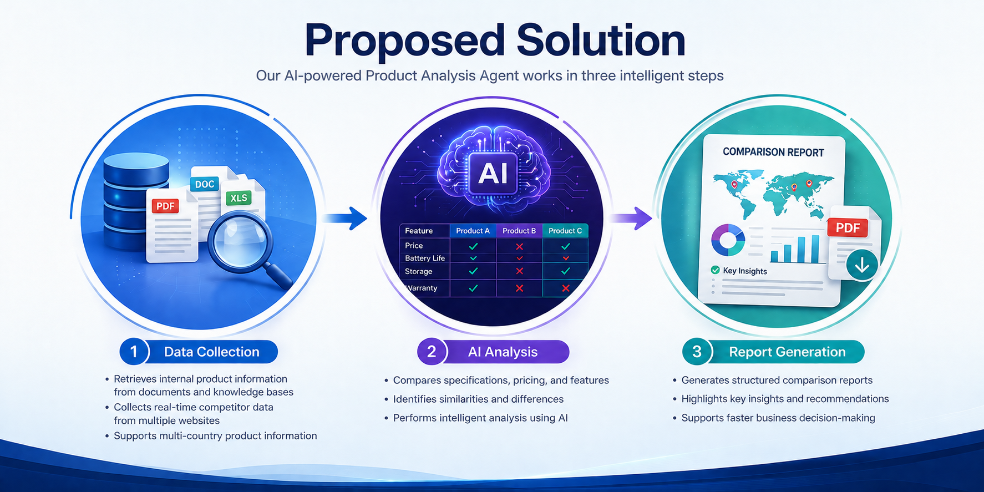
Proposed Solutions
Centralized Product Knowledge Repository
Store all internal product documents, PDFs, specifications, pricing, and availability data in a centralized Azure AI Search repository.
Product Decision Matrix
Provides a structured comparison of multiple products based on price, specifications, performance, availability, and other business requirements, enabling decision-makers to quickly identify the most suitable product.
Automated Multi-Country Competitor Research
Use a Country Research Agent connected to web search services (MCP) to collect competitor product information from official vendor websites
Procurement Alert System
Sends alerts when important changes occur, such as product unavailability, price increases, new alternatives, or supplier changes.
Automated Insight & Report Generation
Generate structured comparison reports with match scores, pricing analysis, availability insights, recommendations, and visual dashboards.
Automated Procurement Workflow
Extends the platform from analysis to execution by supporting recommendation → approval → purchase request → procurement tracking, while keeping human approval in the loop.
Al-Powered IT Procurement Competitive Product Intelligence • iLink Digital Hackathon 2026

Slide 5
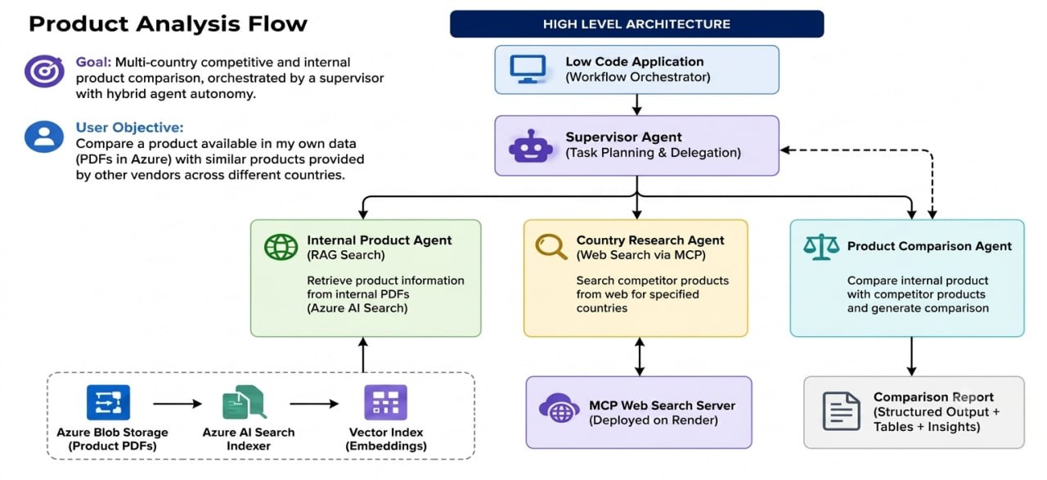
High-Level Architucture
Technology Stack
Frontend: Low-Code Application
Orchestration: Supervisor Agent
Internal Search: Azure AI Search (RAG)
External Search: MCP Web Search
Storage: Azure Blob Storage
Output: AI Comparison Report
1. Low-Code Application
User selects product
Starts workflow
2 Supervisor Agent
Plans tasks
Coordinates AI agents
3. Internal Product Agent
Retrieves product data
Uses Azure AI Search (RAG)
6. Product Comparison Agent
Compares features
Identifies differences
7. Comparison Report
Generates AI-powered insights
Summarizes key findings
4. Country Research Agent
Searches competitor products
Collects country-specific data
5. MCP Web Search Server
Provides real-time web information
Retrieves official product details
Al-Powered IT Procurement Competitive Product Intelligence • iLink Digital Hackathon 2026

Slide 6
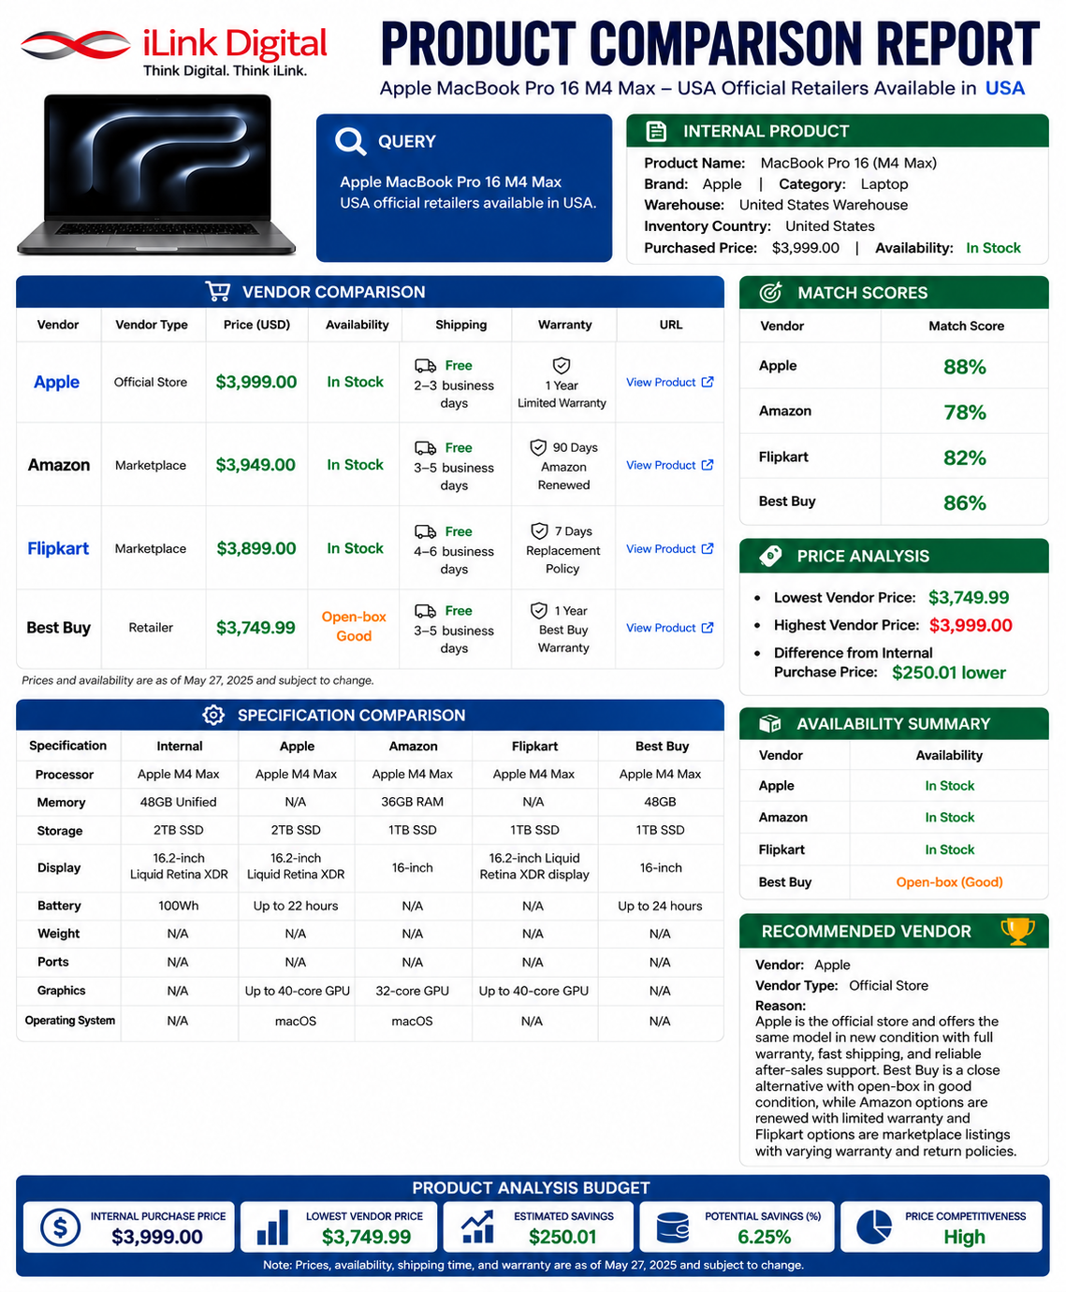
Product Comparison
The Product Comparison Report compares internal and competitor products using data from the knowledge base and official vendor websites. It provides pricing, technical specifications, availability, warranty details, and product
match scores. The system uses AI-powered analysis and recommendations to identify the most suitable product based on user requirements. By combining internal data with real-time external information, the solution improves accuracy,
reduces manual research effort, and saves time.
Compares internal products with multiple official vendors.
Displays pricing, availability, shipping, and warranty details.
Calculates AI-based product match scores.
Performs pricing and availability analysis.
Highlights key differences and advantages between products.
Recommends the best vendor based on overall comparison.
Generates a professional report for quick business decisions.
Al-Powered IT Procurement Competitive Product Intelligence • iLink Digital Hackathon 2026

Slide 7
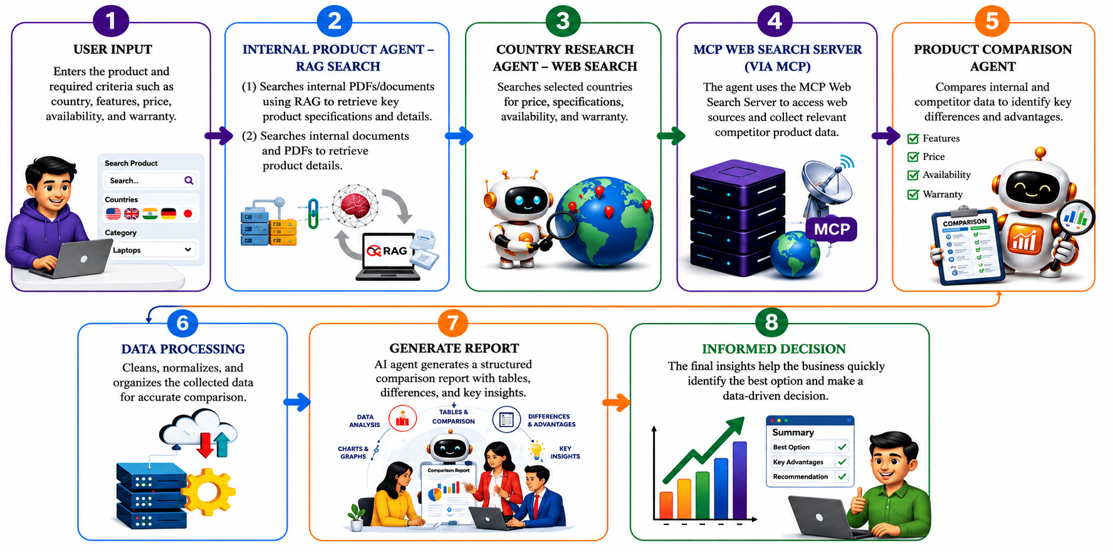
Work Flow
Al-Powered IT Procurement Competitive Product Intelligence • iLink Digital Hackathon 2026

Slide 8
Industries Utiliziations
Enterprise IT procurement
Compares IT products, specifications, pricing, vendors, and availability before purchasing.
Multi-country procurement
This is one of the strongest matches because your system compares products and market information across different countries.
Manufacturing procurement
Manufacturers need to compare equipment, components, specifications, suppliers, and prices before purchasing.
IT asset management
Compares IT assets using specifications, pricing, availability, and vendor data to support efficient procurement and replacement decisions.
Industrial supply chain
Helps compare suppliers, product availability, pricing, and regional differences to improve supply-chain decisions.
Wholesale/distribution
Distributors can compare products from multiple vendors based on price, availability, specifications, and market conditions.
Al-Powered IT Procurement Competitive Product Intelligence • iLink Digital Hackathon 2026

Slide 9
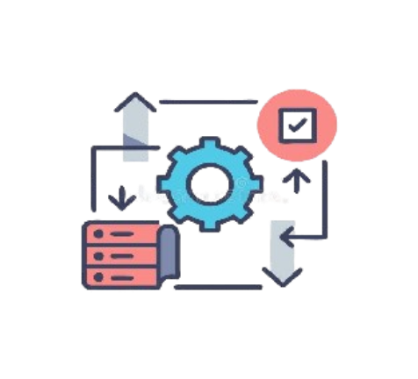
Features And Benefits
Multi-Country Analysis Compares
products across different countries
to identify regional differences.
Customizable Comparisons
Customizable Comparisons
Allows users to select products, parameters, and metrics based on their specific needs.
01
02
Faster Decision Making
Provides accurate product insights
to support quick and informed
business decisions.
Automated Report Generation
Creates structured comparison report
with key insights automatically.
08
03
RAG-Based Knowledge Retrieval
Retrieves accurate information from internal product documents using
semantic search.
User-Friendly Interface
Provides simple navigation and an intuitive dashboard for a smooth user experience.
07
04
Time & Effort Saving
Reduces manual research improves
efficiency and minimizes human errors.
06
Scalable & Secure Platform
Scalable & Secure Platform
Handles large datasets securely and can scale with changing business requirements.
05
Product Comparison Analyzer • iLink Digital Hackathon 2026

Slide 10
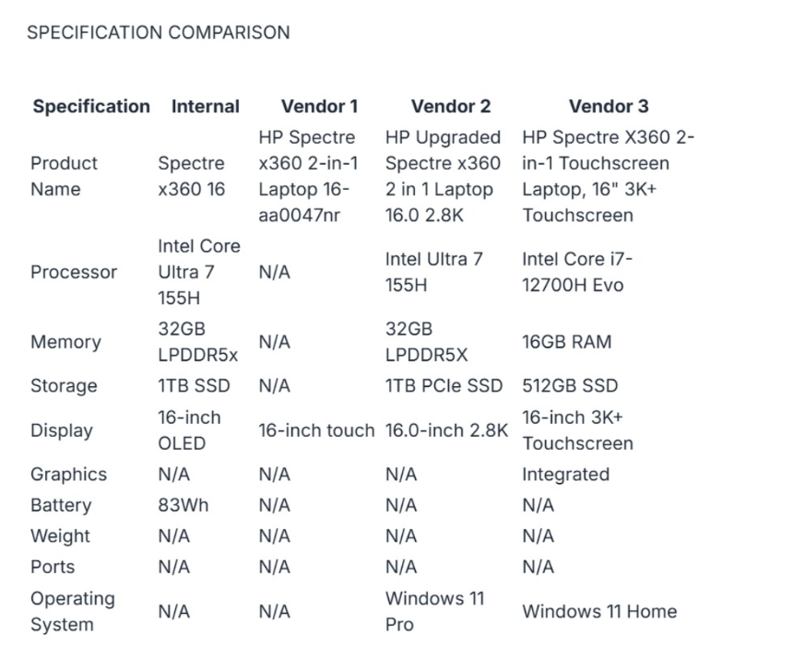
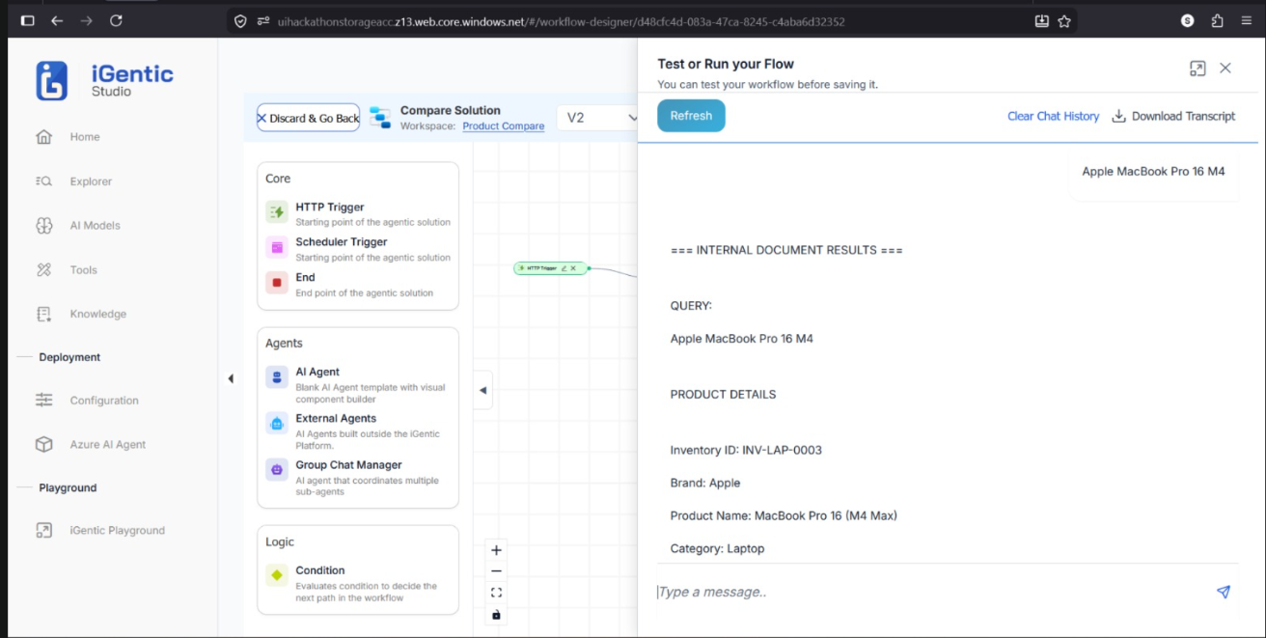
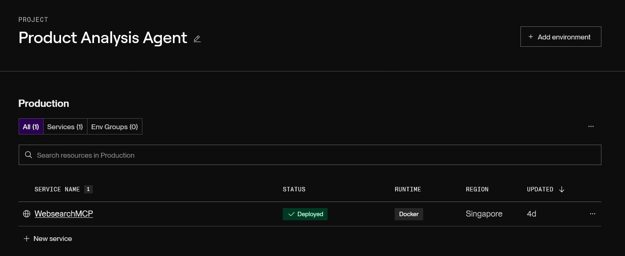
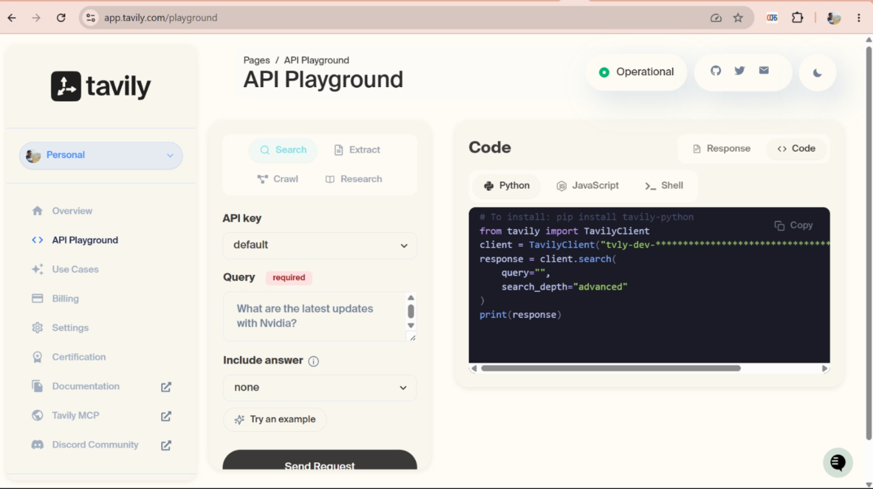
Working Pictures
Al-Powered IT Procurement Competitive Product Intelligence • iLink Digital Hackathon 2026

Slide 11
Thank You !
Al-Powered IT Procurement Competitive Product Intelligence • iLink Digital Hackathon 2026
Product Comparison Analyzer • iLink Digital Hackathon 2026

